Slide 1


UNIVERSITY LIBRARY MANAGEMENT SYSTEM
DSED-08 Major Project
By: Dimple Sharma

Slide 2
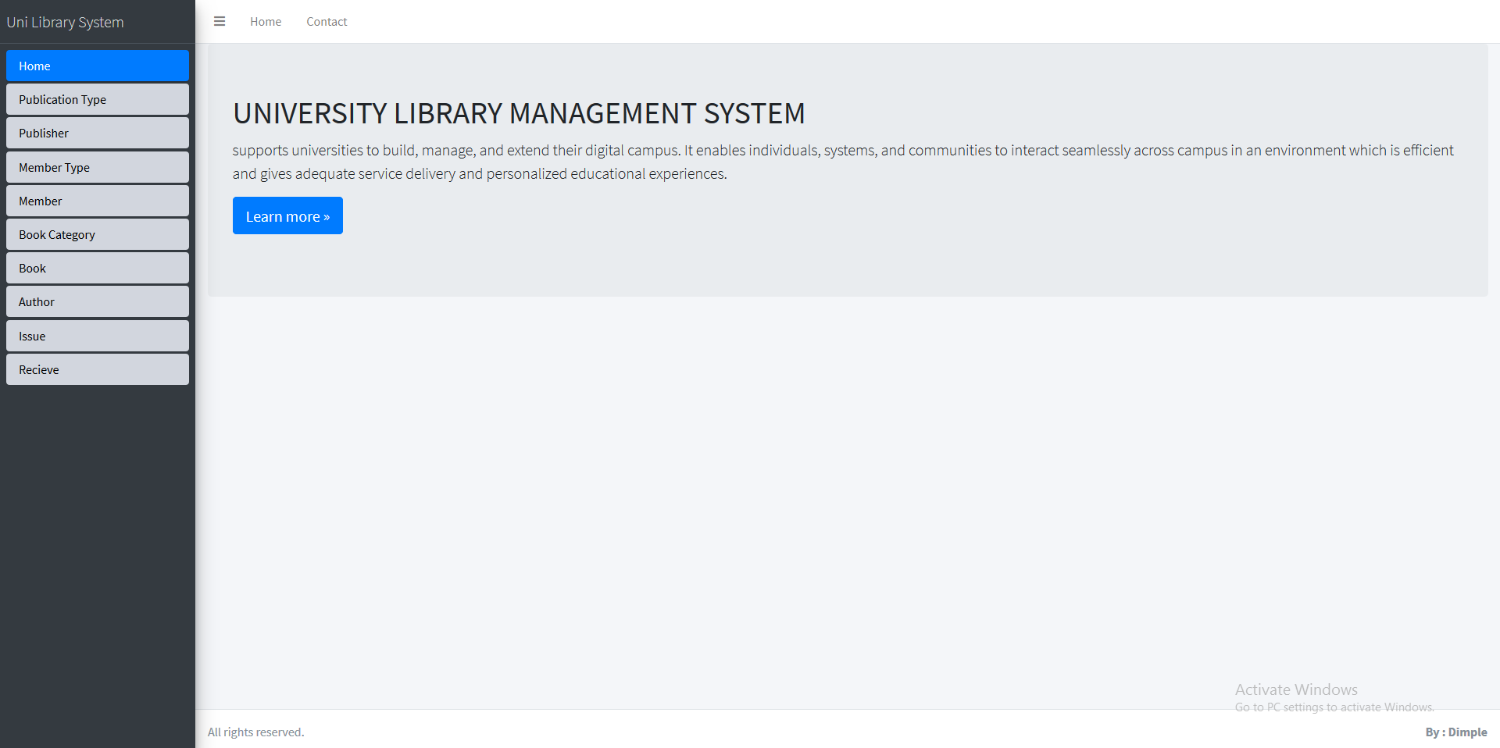
With this system we can manage:- . Facility enrolments . Books . Publisher . Members . Fines . Book’s issue and receiving

Slide 3
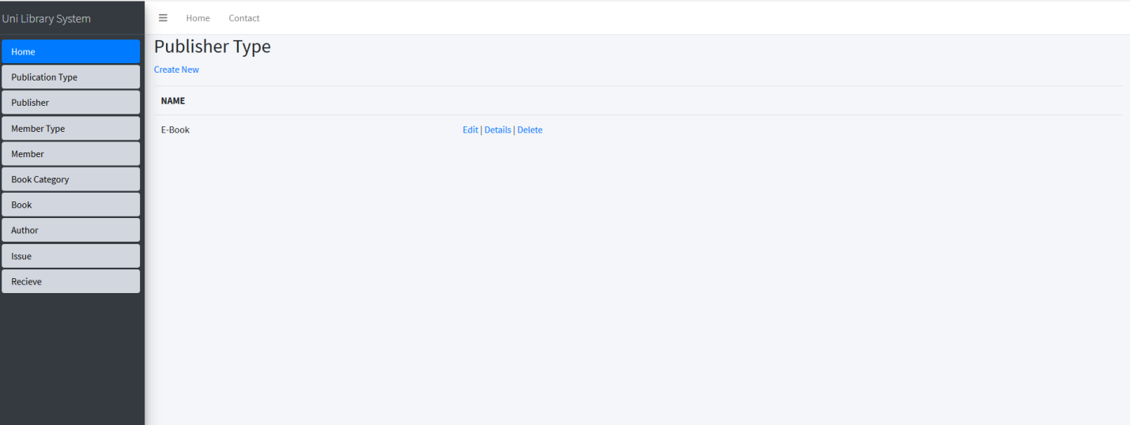
Create & Publisher
In this web application you can create, edit and delete your publisher as shown in the pictures

Slide 4
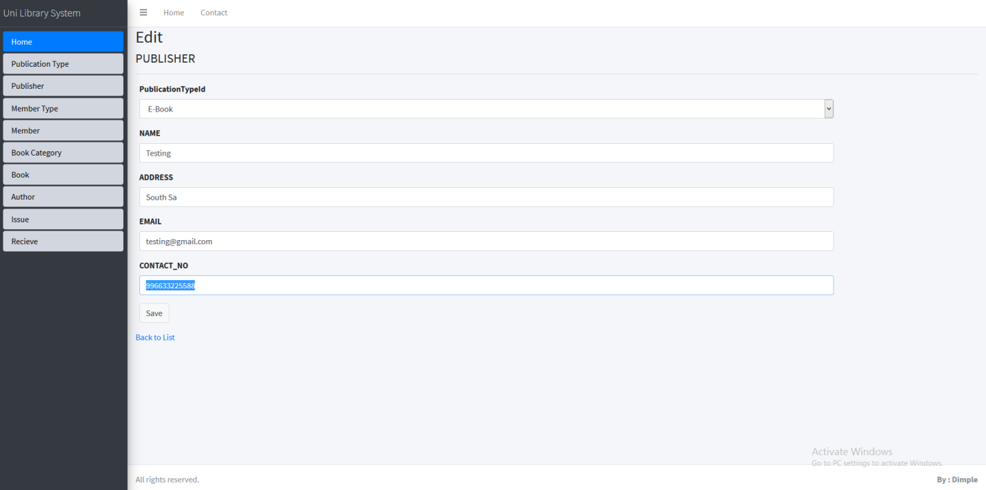
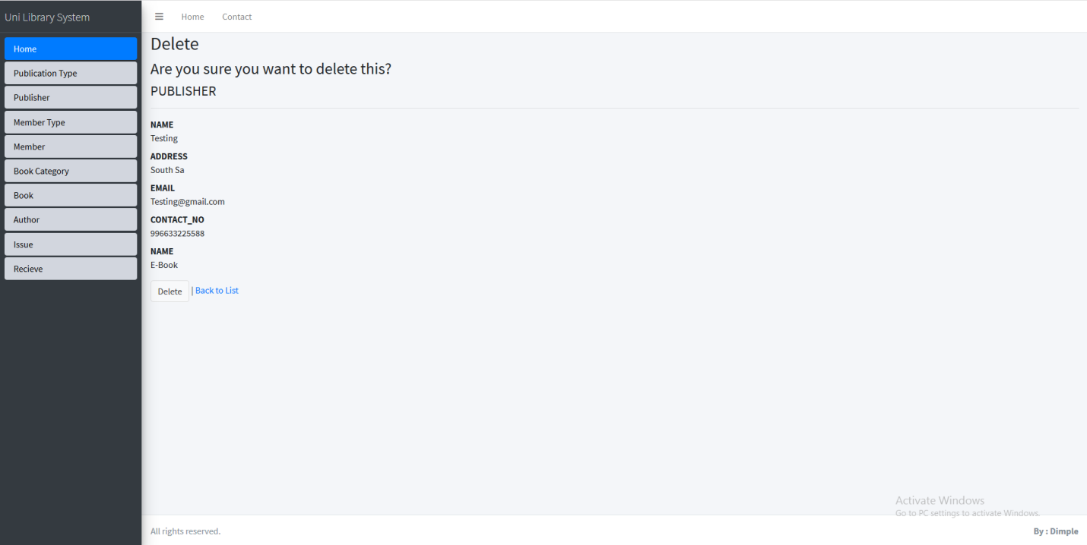
Edit and Deleting Publisher
>>This portal made the process to edit or delete any publisher so easily. You can edit any detail and delete any user or publisher. An illustration is shown on the right.

Slide 5
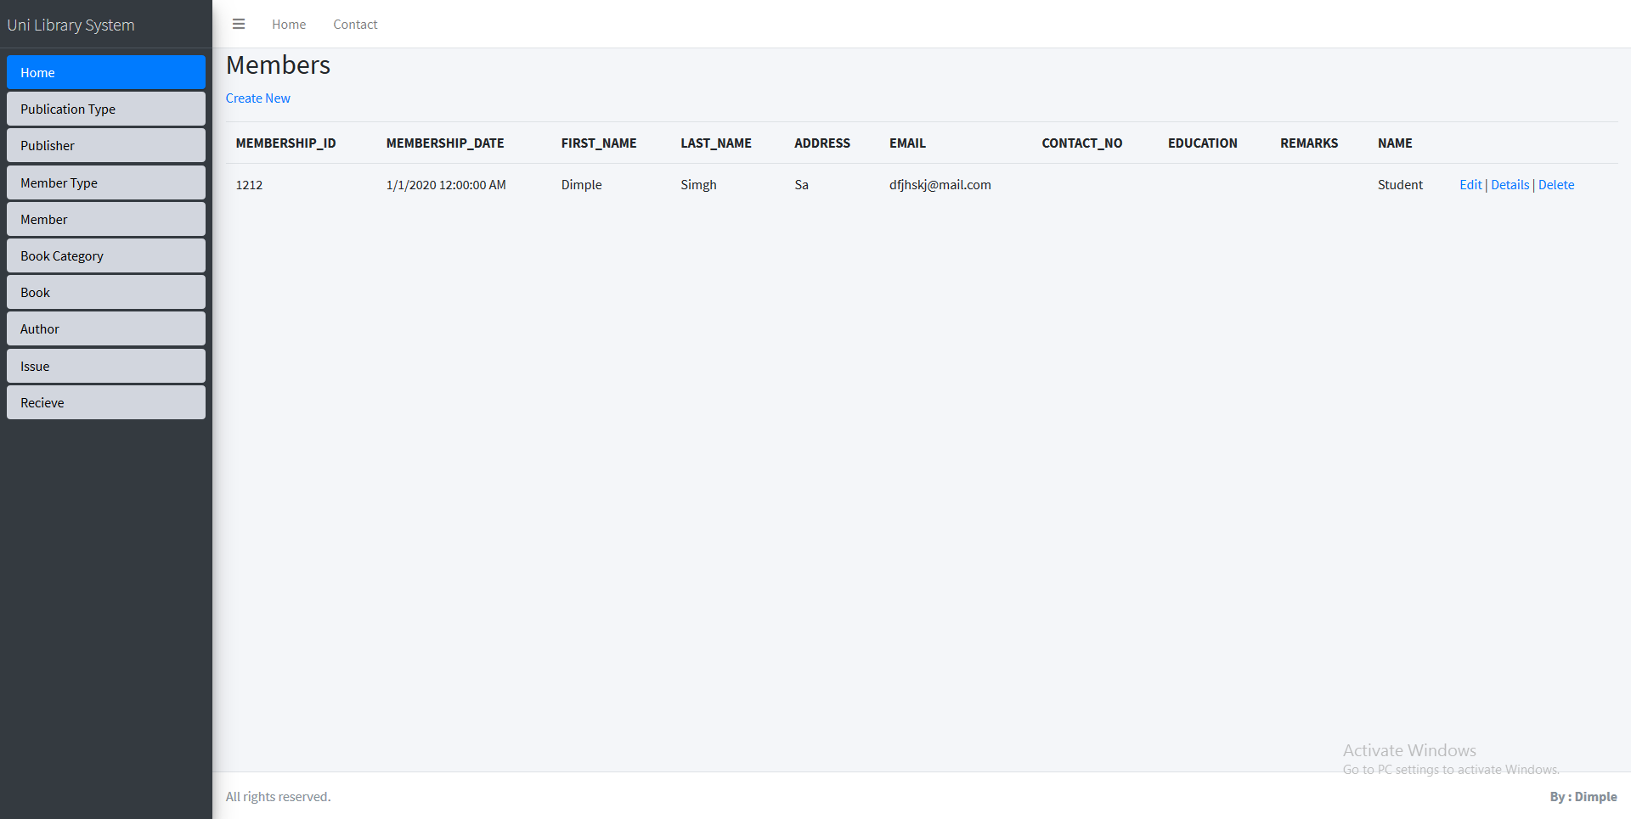

Member And Author Management
This web application help you to manage your members, members type and authors where a user can change the member type and there members information easily. This Portal is much intuitive and easy to navigate.

Slide 6
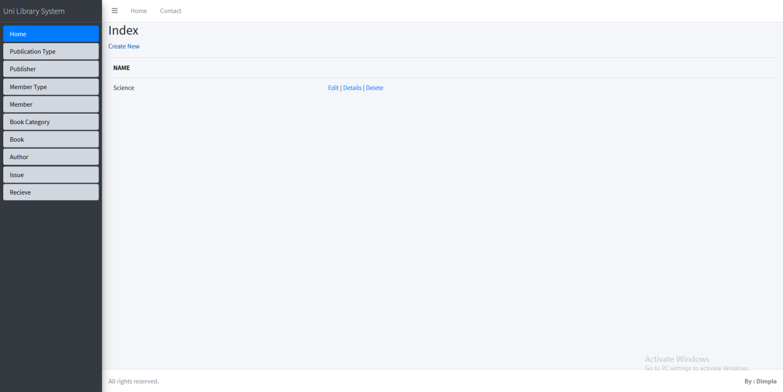
Book Category Management
In this navigation, you can manage the categories of your book and a user can delete, edit or view it anytime in the portal.

Slide 7
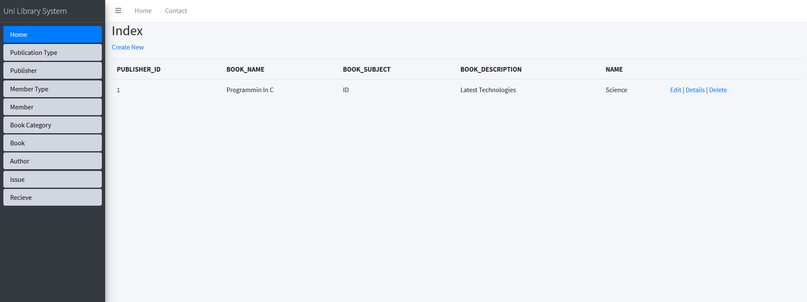
Books Indexing
You can easily get the information of the book from the Book section.

Slide 8

Issue Books
This section of the portal will help to store the information of the book name, whom you issue to and for how many days. Moreover, this will help you get an idea of fine issued under that particular member’ name.

Slide 9
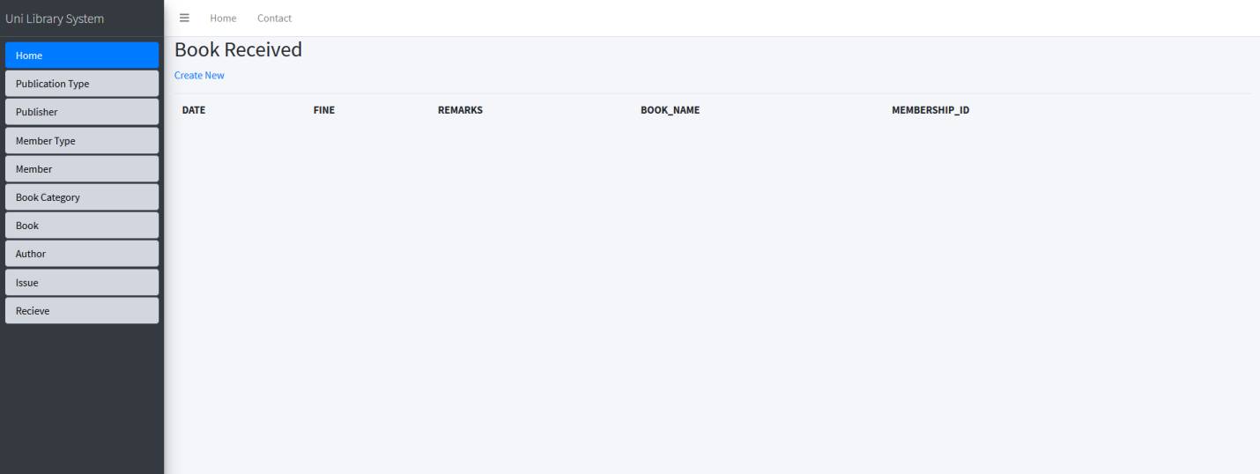
Book Received
Store all the information of returned/received books here in this section of the application.

Slide 10
Project Schedule and Time Management
Objectives | Expected Time | Due Date
Project Selection | 1-2 days | 27/02/2020
Research and Analysis | 2-3 days | 29/02/2020
Project drafting | 1 day | 02/03/2020
Applying Project Methodology | 1-2 days | 04/03/2020
Division of project-project deliverables | 1-2 days | 06/03/2020
Project Completion and formation | 3-5 days | 11/03/2020
Project mentoring | 1 day | 12/03/2020
Project Testing and Execution | 1-3 days | 15/03/2020
Documentation and Presentation Completion | 1-3 days | 18/03/2020
Project Acceptance | 1-2 days | 20/03/2020

Slide 11

Final Product
University Library Management System which supports universities to build, manage and extend their digital campus. It enables individuals, systems, and communities to interact seamlessly across campus in an environment which is efficient and gives service delivery and personalized educational experiences. In this system, we can manage student’s/ facility enrolment, publications, members, books, Fine management and Issued books and receive back.

